Slide 1
Greg Coker www.KC4L.org www.gregcokerdevelopment.com
Next-Level Leadership: The Skills Needed & the Dynamics that Exist as You Navigate Your Ascent

Slide 2
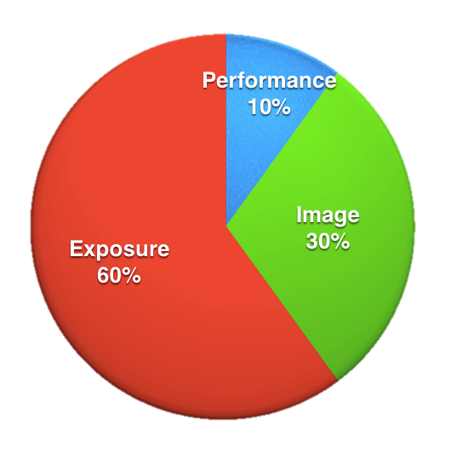

Slide 3
Performance alone will not necessarily get you to the Next Level.
Notes:
\

Slide 4
Next-Level Presence
Notes:
\

Slide 5
Next-Level Presence
Presence is a combination of confidence, poise and authenticity.
As you make your ascent; the more presence is expected and required.

Slide 6
These tools include but not limited to:
Enhancing Person Brand & Re-Branding
Communication Excellence
Emotional Intelligence
Developing & Comminating a Compelling Vision
Understanding How Others Experience You
Cultivating Your Network

Slide 7
Operating Effectively Under Stress
Embracing VUCA (Volatility, Uncertainty, Complexity, Ambiguity)
Conveying Complex Ideas Through Stories
Building Trust
The Power of Vulnerability
Knowing When & When Not to Show Up
Becoming a Great Storyteller

Slide 8
Next-Level Leaders know and appreciate the difference between Management & Leadership.
Notes:
\

Slide 9
Next-Level Leaders also understand the importance of Followership!
Notes:
\

Slide 10
Next-Level Leaders understand the value of the Left Tackle!
Notes:
\

Slide 11
Leadership is important but it’s Followers who really make the difference in creating a movement!
Notes:
\

Slide 12
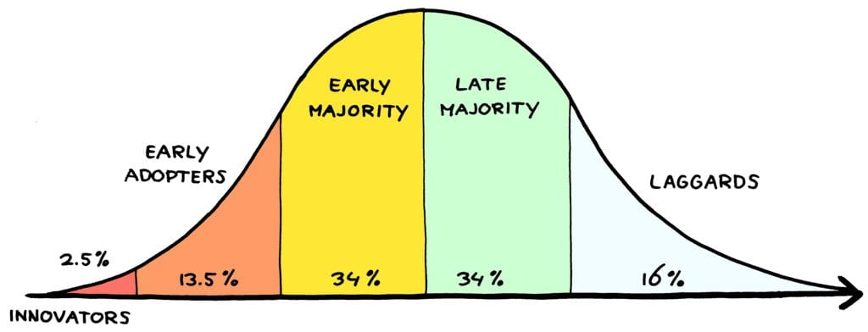

Slide 13
Next-Level Leaders are
Multipliers

Slide 14
Next-Level Leaders Delegate!

Slide 15
Delegate Unless You Can…
Lead Through It (you have unique skills/experience for the task at hand that others do not)
Learn From It (a unique opportunity to build lacking skills/experience that will ultimately make you a better leader.

Slide 16
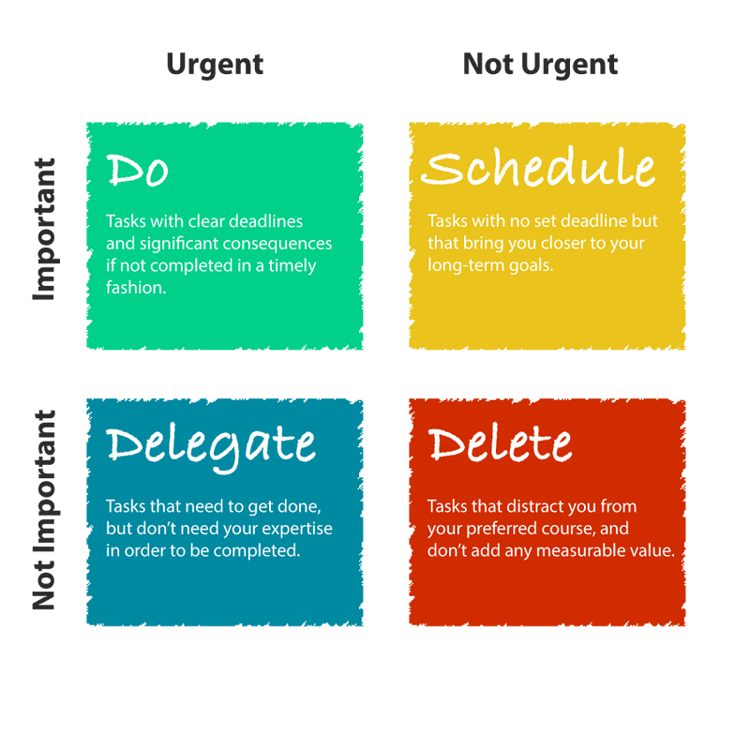

Slide 17
Next-Level Leaders are Aware of the Shadow they Cast.
Notes:
\

Slide 18
When top leaders are asked if they act as a role model for desired culture change, 86% respond YES. Only 53% of their direct reports concur.
Notes:
\

Slide 19
Next-Level Leaders are Bus Drivers
Notes:
\

Slide 20
Right People on the Bus (Recruitment/Selection)
Right People in the Right Seat (Alignment)
Wrong People off the Bus! (With self-esteem intact if possible)

Slide 21
Next-Level Leaders Deliver on the Four Things Followers Really Want
Notes:
\

Slide 22
Trust
Compassion
Stability (in times of VUCA)
Hope

Slide 23
Next-Level Leaders are Fully Engaged!
Notes:
\

Slide 24
ENGAGEMENT
26% of Leaders are Fully Engaged
55% of Leaders are Partially Engaged
19% of Leaders are Totally Disengaged

Slide 25
Next-Level Leaders are WIG Focused
Notes:
\

Slide 26
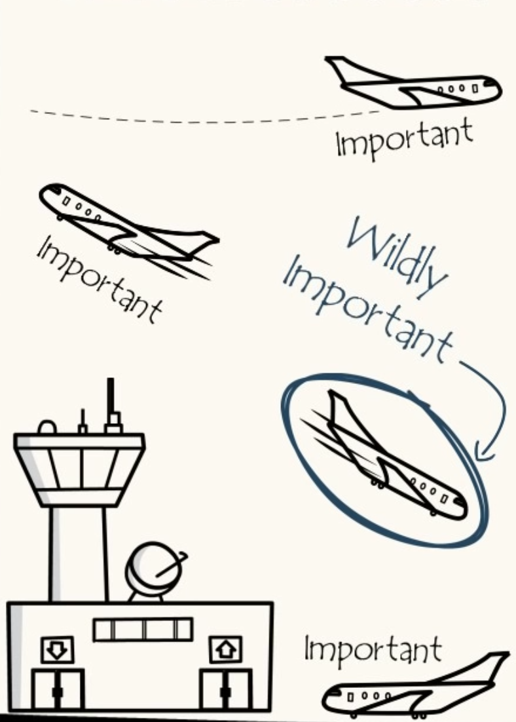

Slide 27
Next-Level Leaders are Driven by Three Questions
Notes:
\

Slide 28
What’s going well?
Where, if at all, are you/we getting stuck?
What should you/we be doing differently moving forward?

Slide 29
Next-Level Leaders Realize Some Ships Need Burning!

Slide 31
Next-Level Leaders Value Victory over Winning
Notes:
\

Slide 32
Winning: Go to war, lose soldiers, win the battle, you come home as one of the few survivors. Victory: Go to war, win the battle, everyone makes it home.
Notes:
\

Slide 33
Next-Level Leaders Send Handwritten Notes!

Slide 34
According to psychologists, receiving appreciation and acknowledgment releases dopamine and serotonin in the brain. So does expressing it. Whether it’s received or written, gratefulness automatically redirects the mind to the present.

Slide 35
Next-Level Leaders Are Flow Focused!

Slide 36
THE FLOW STATE
The optimal state of mind when you perform your best and feel your best.

Slide 37
THE FLOW STATE
Moments of total absorption, when we are fully energized, focused and immersed in the process of our activity and achieving optimum performance.

Slide 38
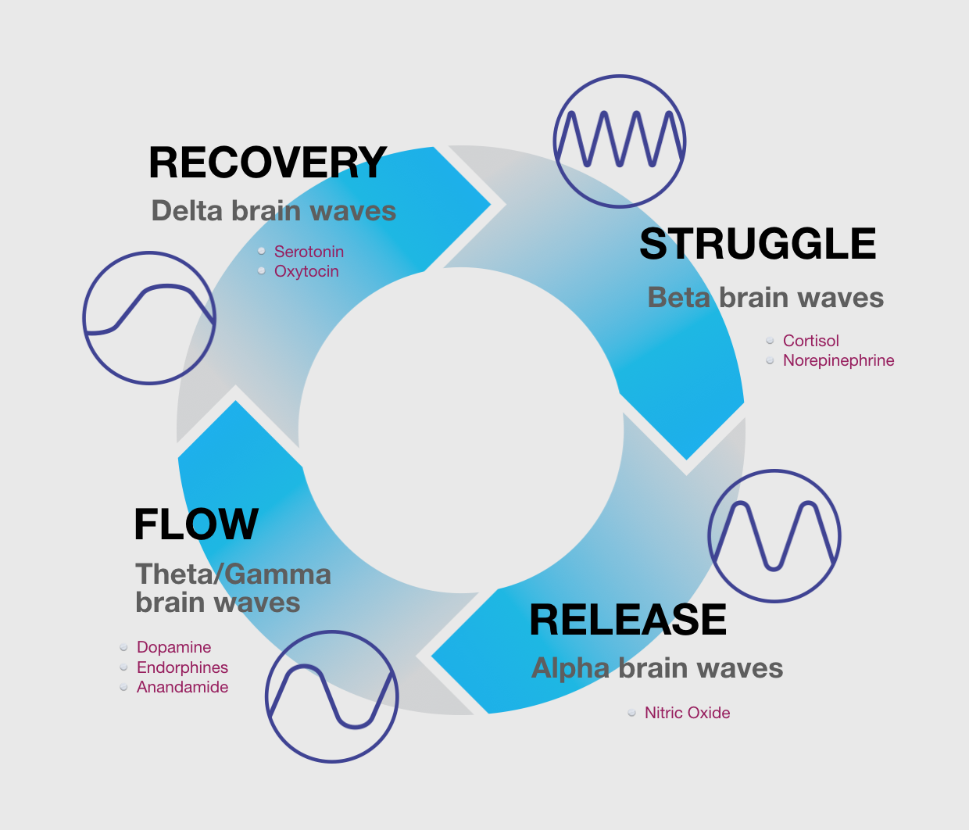

Slide 39
Next-Level Leaders Own Culture

Slide 40
“Culture eats strategy for breakfast.” Peter Drucker (management guru)
Notes:
\

Slide 41
When leaders are asked if they act as a role model for desired culture change, 86% respond YES. Only 53% of their direct reports concur.
Notes:
\

Slide 42
Next Level Leaders Understand, Appreciate, Maximize
Differences

Slide 43
Task
Analytical
Driver
Ask
Tell
Amiable
Expressive
People

Slide 44
Three Questions Next-Level Leaders Ask Others
Notes:
\

Slide 45
3 Questions You Should Be Asking Others
What’s going better than it was 6 months ago?
What’s not making enough progress or going in the wrong direction?
What’s something you’re afraid no one is telling me and that you believe I need to know?.

Slide 46
Eight Questions Next-Level Leaders Ask Themselves
Notes:
\

Slide 47
What are my priorities and is my time allocated appropriately to them?
Is my schedule so full that unexpected events throw me into a panic?
Am I able to be fully present in every interaction, or am I preoccupied with the past of future?
Have I structured recovery time into my schedule?
What gives me energy and am I making enough time for those things?

Slide 48
6. How do I get feedback on who I am as a leader and what do I do with it?
7. Do I generate energy for others by defining reality and giving hope?
8. Do I have a small group of advisors (kitchen cabinet) who are a candid sounding board?

Slide 49
In Closing, Next-Level Leaders Monitor the Load
Notes:
\

Slide 50
Greg Coker www.KC4L.org www.gregcokerdevelopment.com 270.223.8343

